Slide 1
Comparison of Image Denoising Algorithms
Kartickey Aggarwal
BTech CSE
2018867
Mentor:- Dr. Vidit Kumar
Notes:
A Reverse Turing Test for Estimating Competitive Hardness of Password Recommender System
Entered text
topic - A Reverse Turing test for Estimating Competitive Hardness of Password Recommender System.
The algorithm generates passwords based on the information provided by the user like their first name, last name, date of birth, and father’s name. After the generation each password is tested by the algorithm that how strong each password is, and a score is provided to the password according to its strength tested by the algorithm.
The password strength estimation algorithm tests the algorithm against various methods used by the attackers to crack the password.
• First the algorithm checks the length of the password, whether its 6 characters long or more than that.
• Then the algorithm checks if the password contains any commonly used words that are generally used by majority of users while creating a password and a score is provided according to the test.
• Then the algorithm checks whether the password contains the information of the user without encrypting it in some way or how much the password is predictable based on the information provided by the user.
• Then the password is checked against brute-force attacks i.e., how much time would it take to crack the password.
• After the brute-force attacks, the randomness of the password is checked, checking how predictable can the password be based on how many times a character is repeating in the password.
• Each step provides a relative score to the password and based on the score the password is rated as Easy, Moderate or Hard.

Slide 2
INDEX
INTRODUCTION
METHODOLGY
RESULT AND DISCUSSION
CONCLUSION
FUTURE WORK

Slide 3
Image Denoising Using Deep Learning
This presentation compares various methods used for image denoising. The presentation focuses mainly on DnCNN, UDnCNN and DUDnCNN models.

Slide 4
Introduction
There are various methods available for image denoising.
However, it is difficult to choose which one is better and which one to use.
The project compares loss and PSNR(Peak signal to noise ration) value of each model using MSE loss.
So the project compares various deep learning algorithms used for image denoising

Slide 5
Image Denoising
Sometimes there is a lot of noise in the image because of which a lot of information is lost from it
So, it becomes necessary to denoise them.
There are multiple models available for the purpose, now its our job to choose a suitable model for the job.

Slide 6
Proposed Method
The dataset of images will be given to the model and artificial noise will be added to each one of them
Then the images with the noise will be given to the models to denoise them and their performance will be measured in comparision to the original or the clean image
The comparison is done on the basis of loss calculated by MSE and their respective PSNR values.
We are using 3 models namely- DnCNN, UDnCNN and DUDnCNN model and are comparinf their performances with each other

Slide 7
Working of Model
Each model is trained on 200 epochs on same image and then later their performance is measured by comparing denoised image to clean image
The optimiser used is “Adams” which adjusts the learning rate according to the model and is better than other optimisers like ”ADAGRAD” etc
The activation function used is ReLU which is a better choice is comparision to other approaches as it can handle vanishing gradient problem
The convulational layers used are variable and are based on the values calculated by the optimiser and increases by power of 2

Slide 8

Result Analysis
After training and testing of the models, all the models are compared with each other
Various images are taken into consideration and the the performance of all the models can be clearly seen as they denoise the provided images.

Slide 9

Their PSNR values are compared with each other.
Their loss is calculated using Mean Squared Error loss function

Slide 10
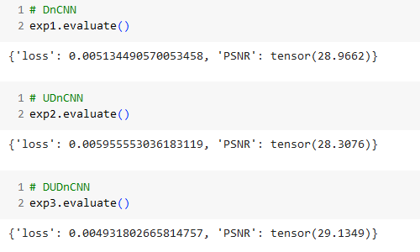
Image Denoising

Slide 11
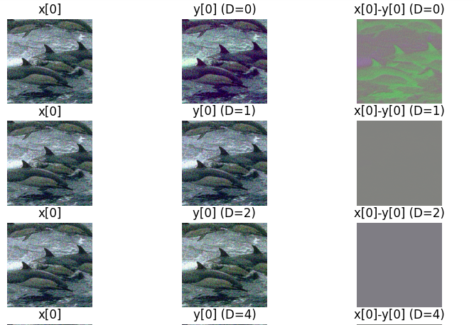

Slide 12
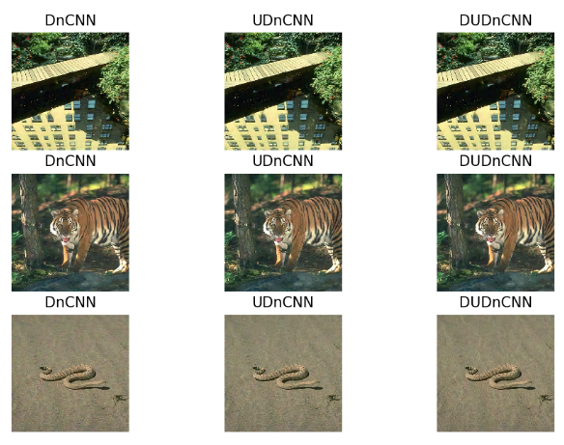
Comparing Images

Slide 13
Conclusion
DnCNN is a promising method to use for image denoising
As compared with other two models UDnCNN and DUDnCNN model, DnCNN performed better than them as less information is lost during denoising
Other methods can also be used depending on the situation like when we don’t have enough resources to train complex networks or when we want global scale of images rather than patches.

Slide 14
Future Work
Deep Learning Architectures: Develop more sophisticated deep learning architectures specifically designed for image denoising tasks. This includes exploring novel network architectures, skip connections, attention mechanisms, and transformer-based models.
Adversarial Learning: Investigate the use of adversarial training methods to improve the robustness of denoising models. Adversarial training can help models generalize better to diverse noise patterns and challenging real-world scenarios.
Transfer Learning and Pre-training: Explore transfer learning techniques and pre-training strategies on large datasets. Pre-trained models on general image datasets can be fine-tuned for specific denoising tasks, leading to improved performance with limited labeled data.
Sparse Representation and Dictionary Learning: Explore sparse representation and dictionary learning methods for image denoising. These methods leverage the sparsity of natural images to learn effective representations and denoise images with less reliance on large datasets.
Real-Time Denoising: Focus on developing denoising algorithms that are optimized for real-time processing, especially for applications like video denoising, live streaming, or embedded systems.
Hardware Acceleration: Explore hardware acceleration techniques, including the use of specialized hardware (e.g., GPUs, TPUs, or custom accelerators) to speed up the inference process, making denoising models more practical for real-time applications.

Slide 15
Thank You

